Slide 1
Network Security
Assignment 1
Herschelle Gupta 2019045
Ritik Vatsal 2019321

Slide 2
Project 0
Encryption & decryption using monoalphabetic substitution of a pair of characters at a time.
<x,y> → <p,q> where x, y, p, q ∈ {A, B, C}
Developing the software to launch a brute-force attack to discover the key.
The plaintext should be long enough and “recognizable”.

Slide 3
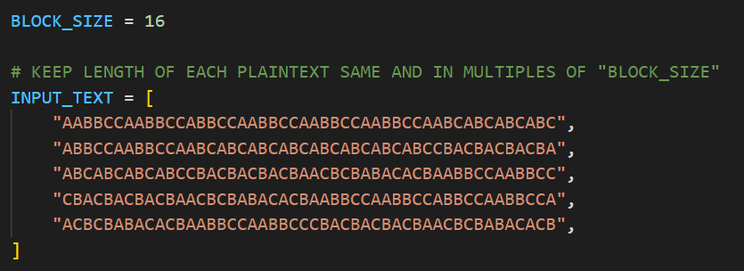
Plaintext and Encode Key
Plaintext is converted to binary bits using the “encode key” shown below.
Ex: A → 00, B → 01 and C → 10.

Slide 4
Hash Function
Block size of 16 is used and number of rounds depends on length of plaintext divided by block size.
For each round -
Formally, let H(i) denote Hash in ith round -
H(i) = Plaintext (in binary) if i = 1
H(i) = H(i) XOR H(i-1) for i= 2 to n (Here XOR denotes bitwise XOR)
H(n) is the final hash value

Slide 5
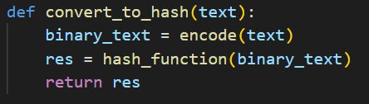
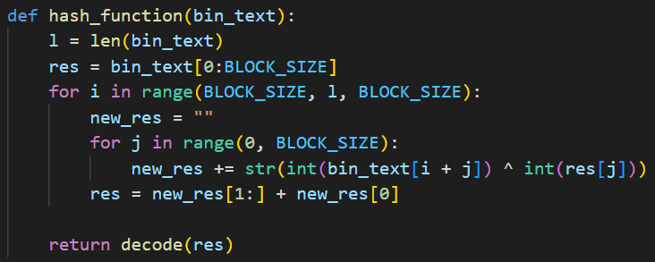
Hash Function

Slide 6
“Recognizable” Plaintext - Hash
We have appended the Hash calculated in the previous stage to the plaintext, and have then encrypted the new plaintext.
Plaintext (original) + Hash of Plaintext (original) = New Plaintext (to be encrypted)
ACCBAAACCBAAACAACBACAACBACAACBACAACBCCBBCACCBBCAAABCCABC
With the assumption that length of the plaintext is known.

Slide 7
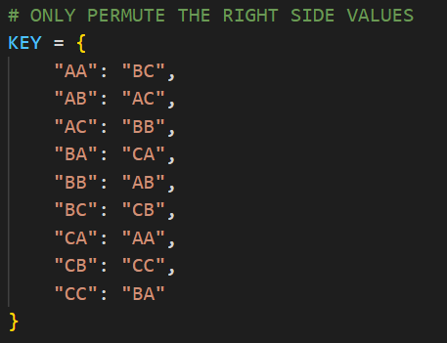
Encryption/Decryption - Key
Key K, is defined as a permutation of 9 values -
{AA, AB, AC, BA, BB, BC, CA, CB, CC} mapping to itself.
Hence, total number of different keys possible are -
9! = 362880
There cannot be any duplicate values on the left or right sides. Why?

Slide 8
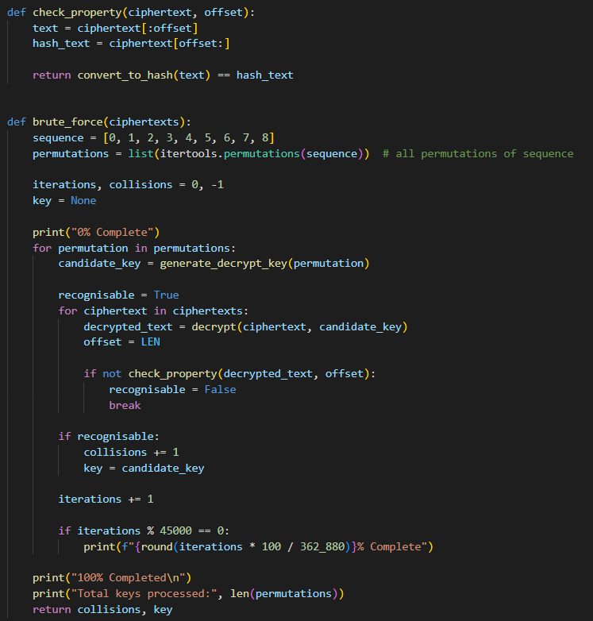
Brute force
We decrypt and check against all possible permutations, checking each of the decrypted plaintexts if it is “recognizable” as declared earlier.
Once a plaintext satisfying this condition is found, that key is returned.

Slide 9
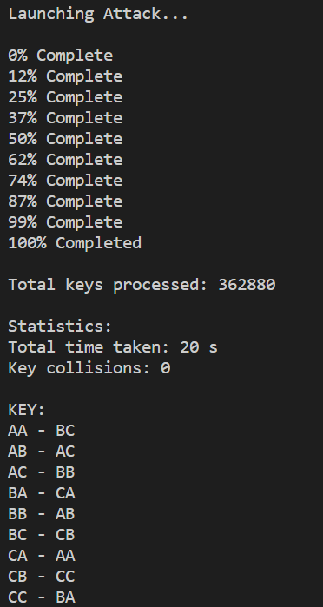
Results
Output will show the progress of brute force algorithm.
Algorithm does not stop even if a key satisfies, it goes on to check for collisions.
More than one key satisfying means the hash function used is weak or bad.

Slide 10
Thank You!

